Slide 1

How to use Korean Fonts in matplotlib

Slide 2

Reference
youtube-jocoding’s Youtube and Code
Youtube on Dataset Flower
Youtube on os Module Functions used in Dataset Flower
Youtube on Downloading Images from Google
Youtube
Code

Slide 3
Downloading Images from Google

Slide 4
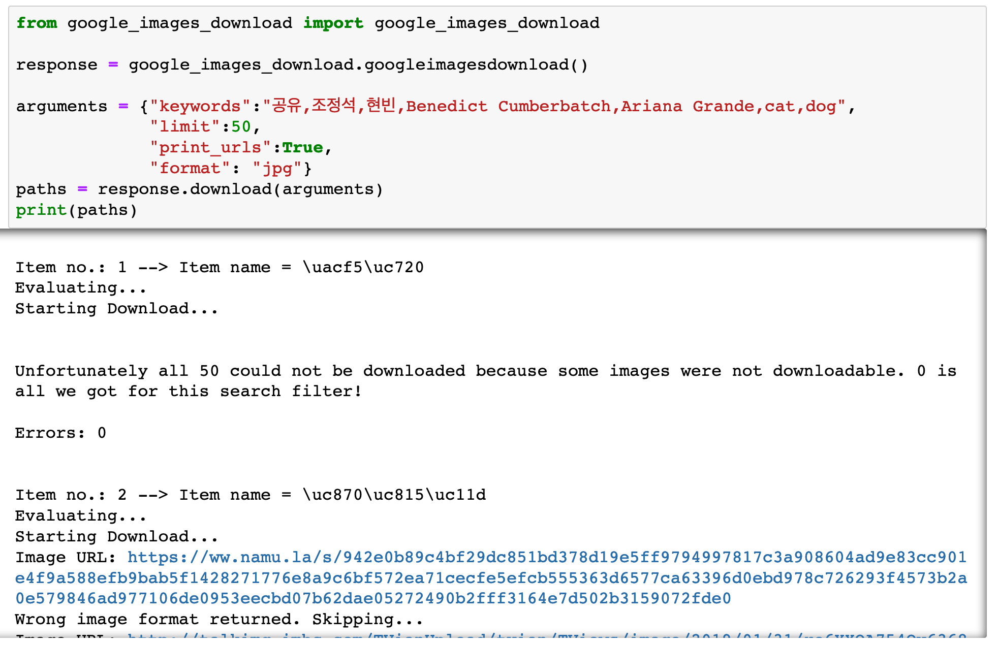

Slide 5
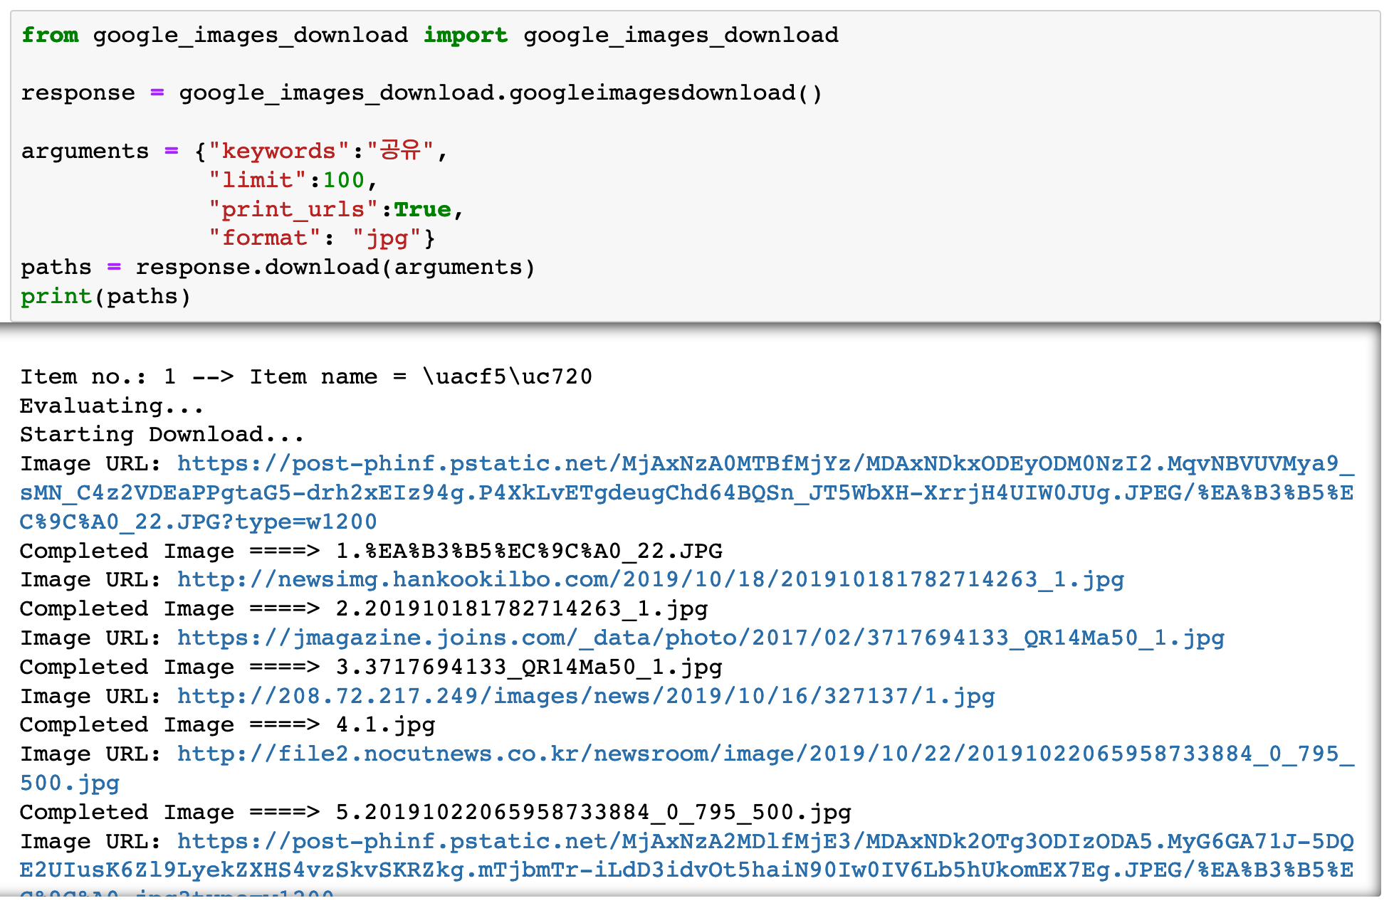

Slide 6
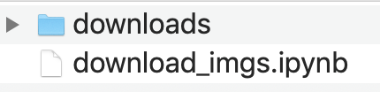

Slide 7
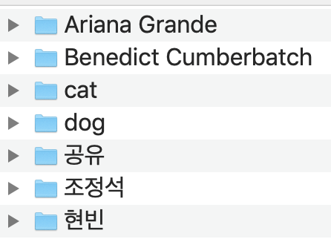

Slide 8
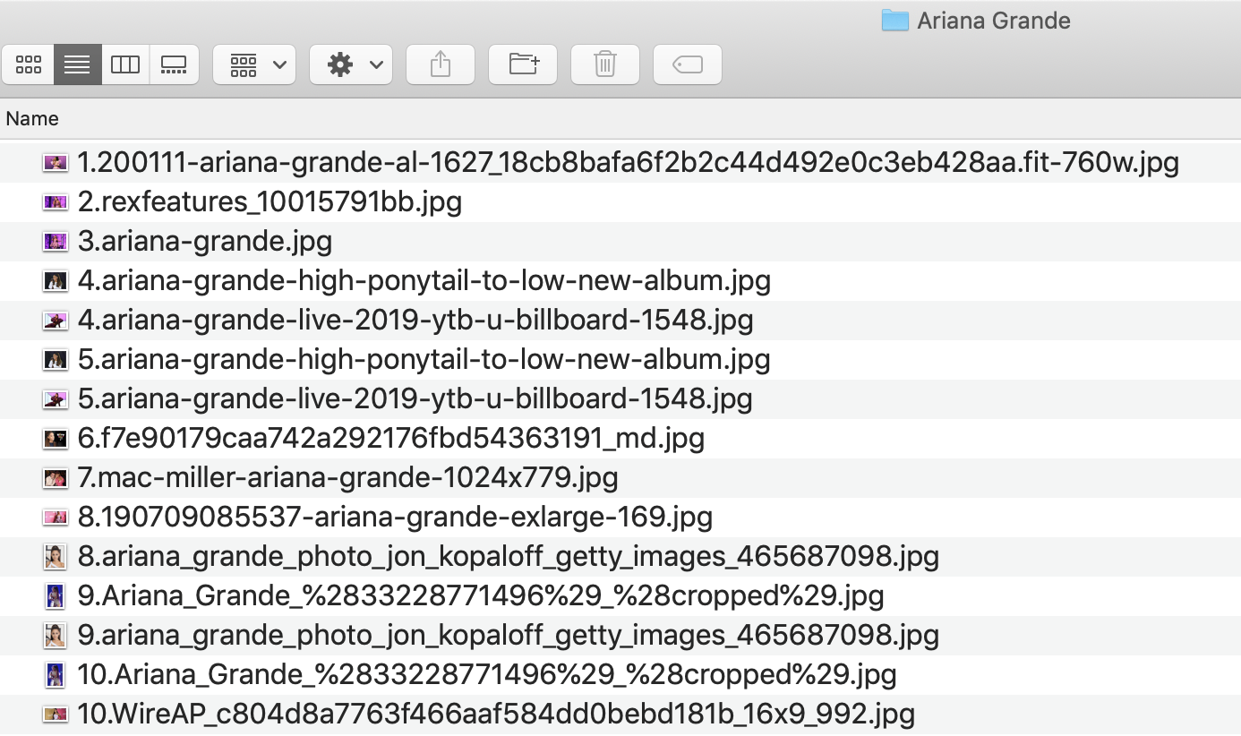

Slide 9
Create downloads _classes list

Slide 10
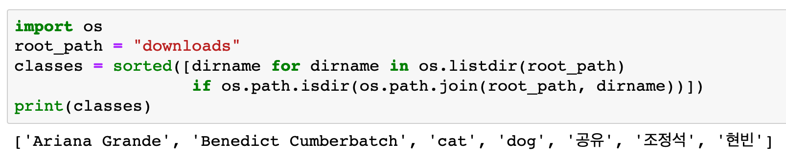


Slide 11
Create image_paths dict

Slide 12
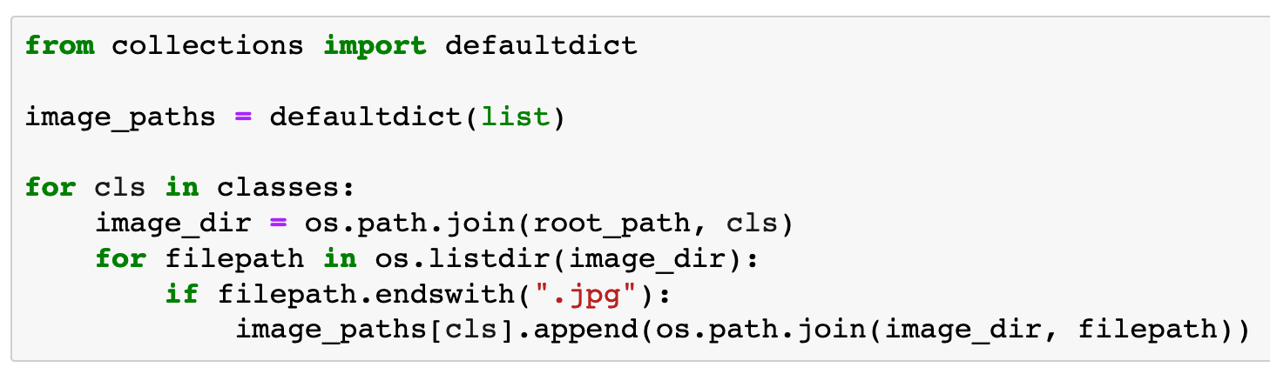

Slide 13
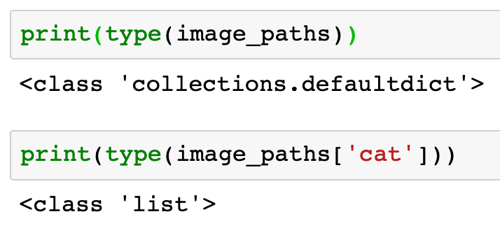


Slide 15
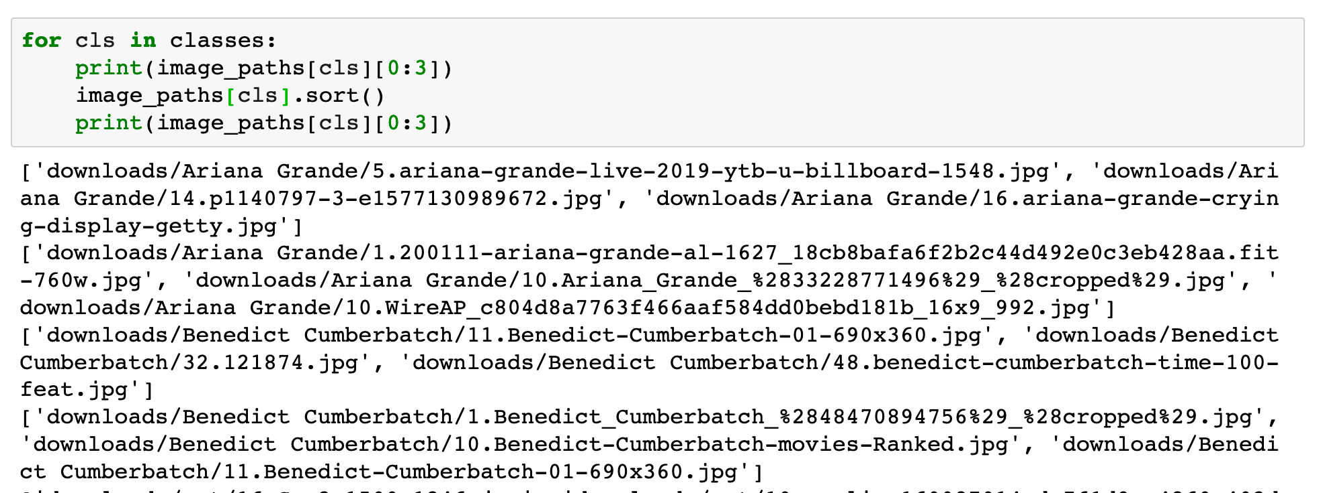

Slide 16
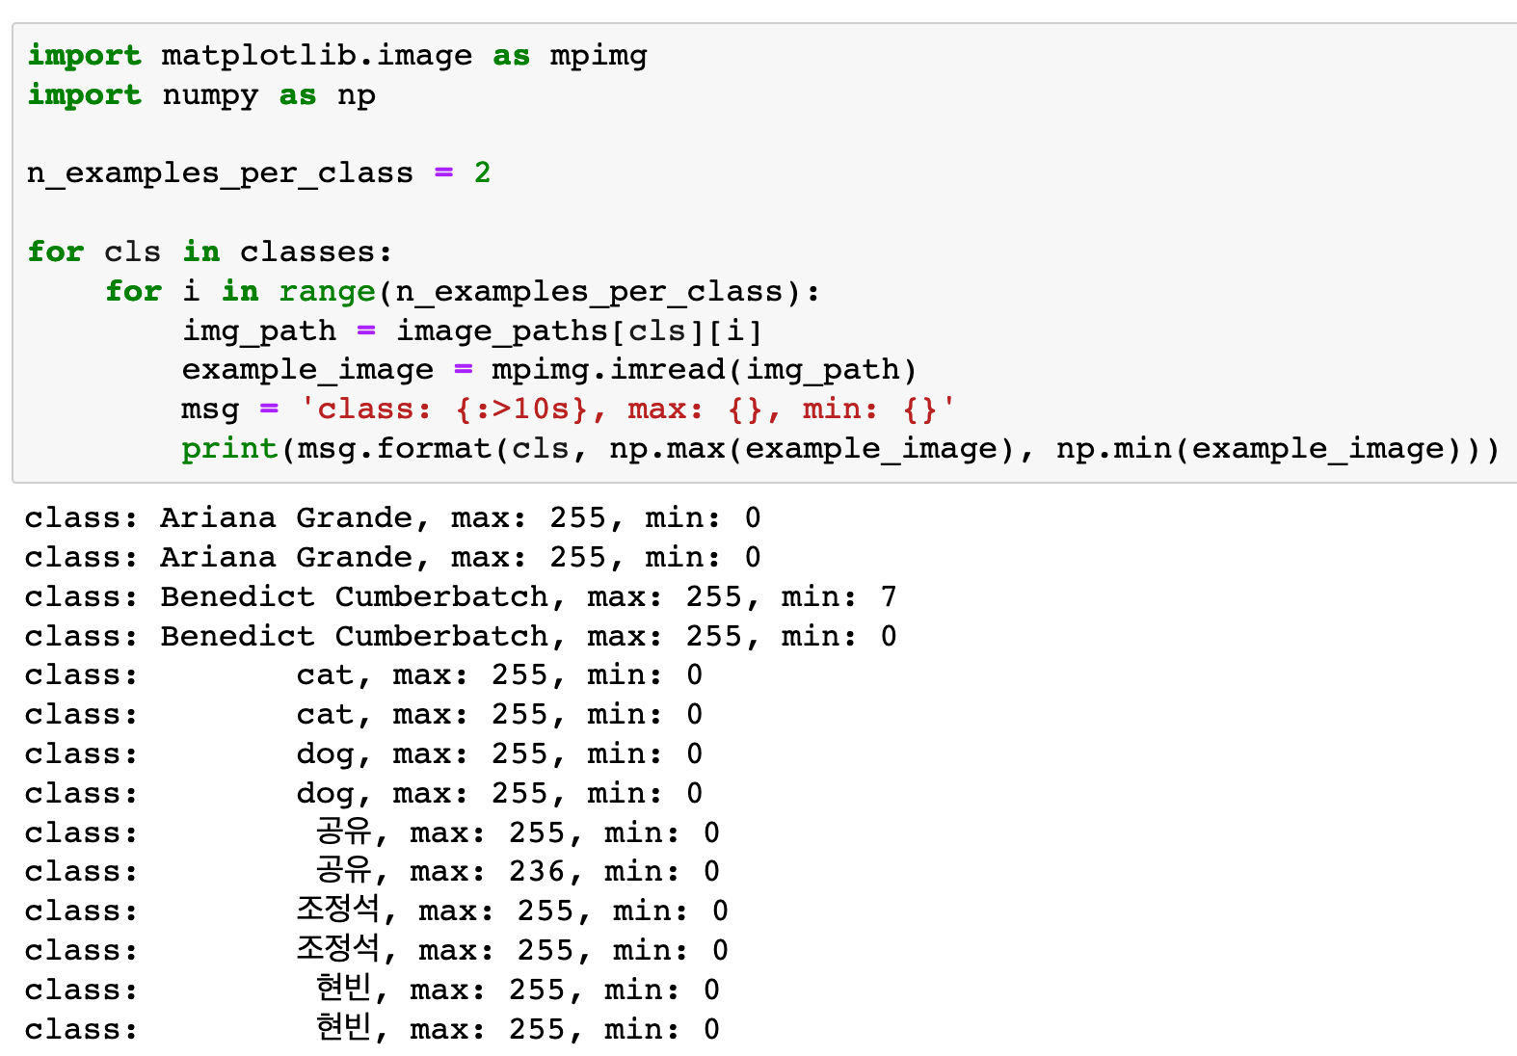

Slide 17
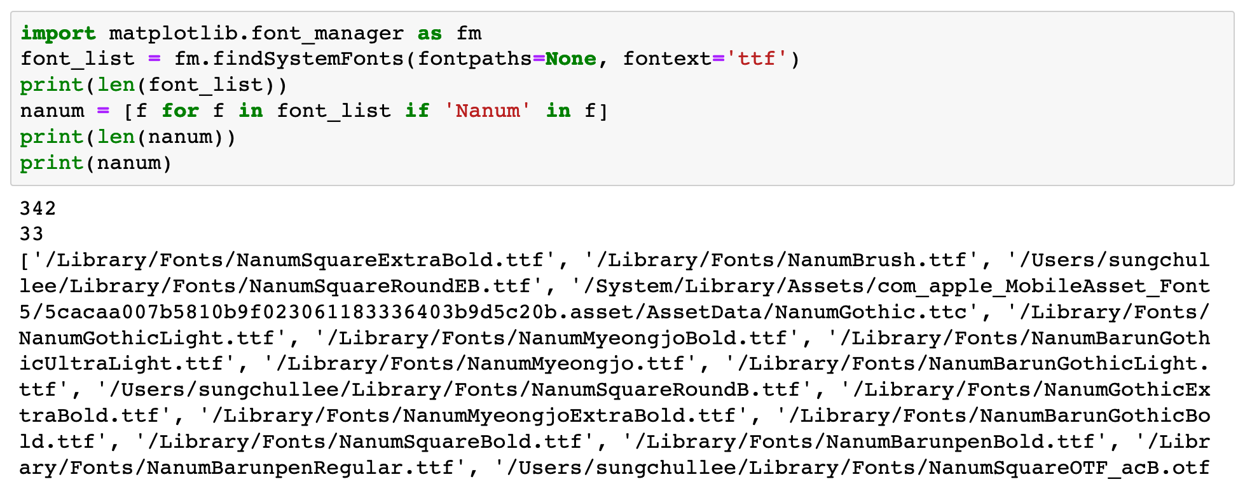

Slide 18
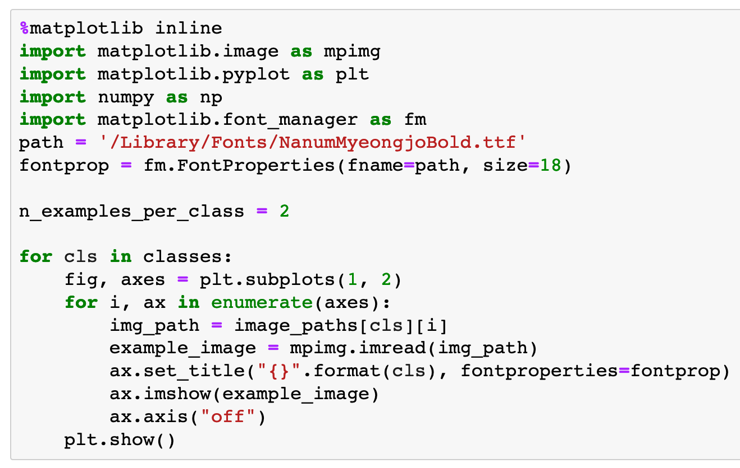

Slide 19
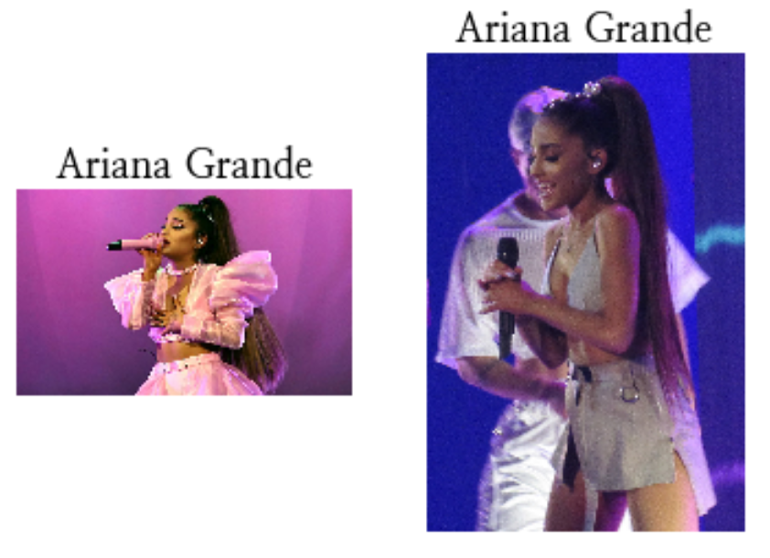

Slide 20
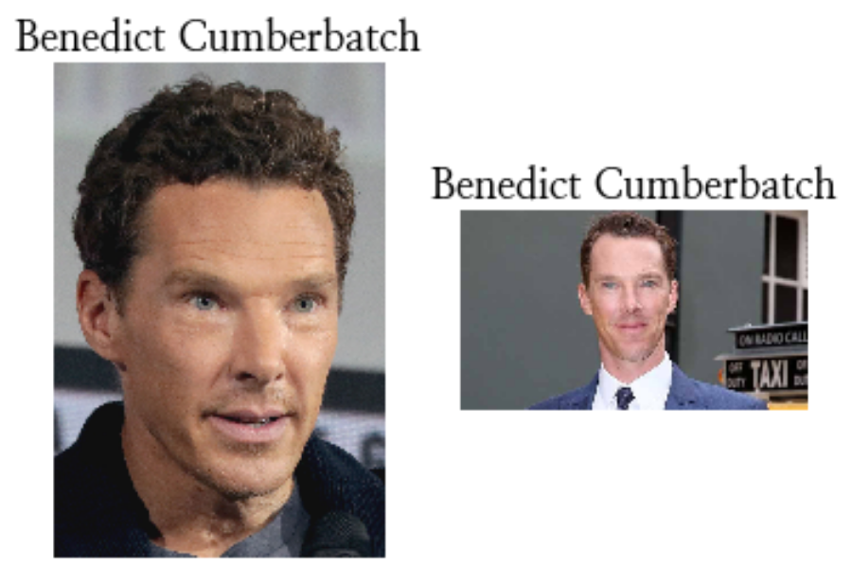

Slide 21
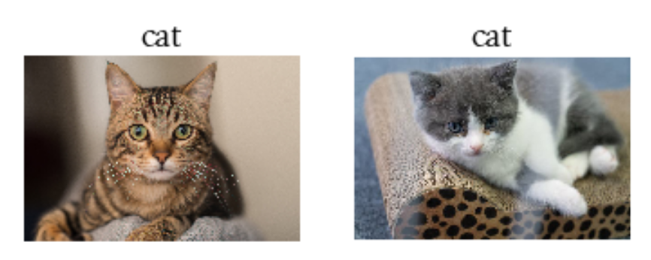

Slide 22
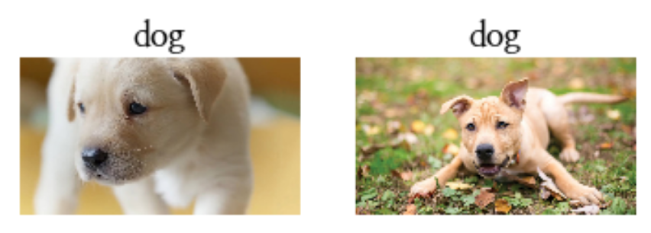

Slide 23
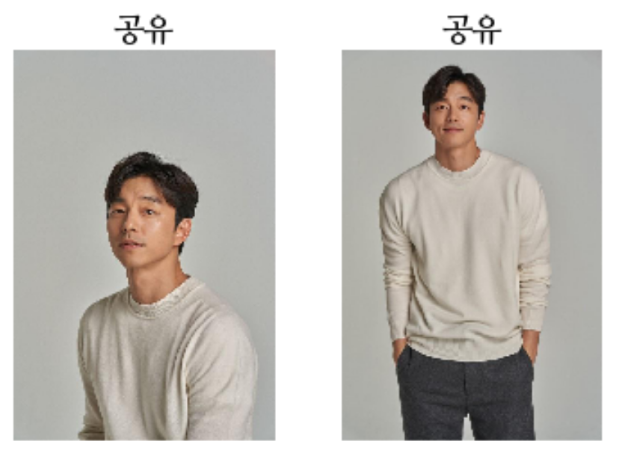

Slide 24
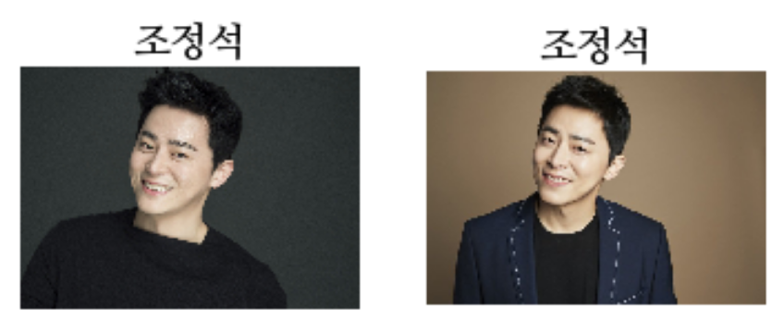

Slide 25
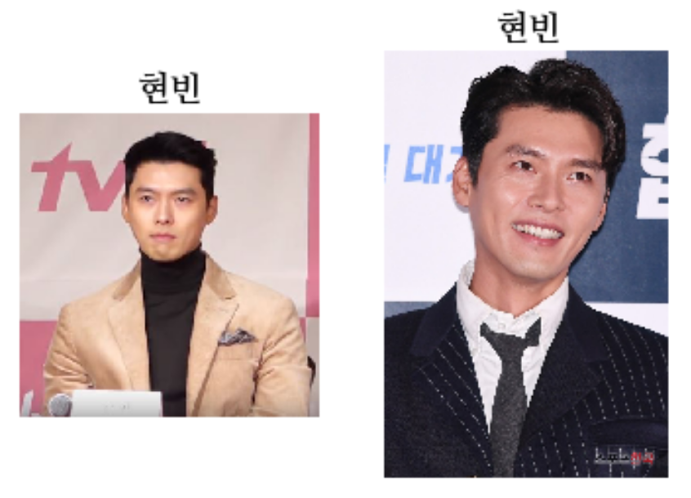

Slide 26
Now
Let’s Play with Code

